Slide 1
Optimizing Fleet Management: An Object- Oriented Analysis and Design Approach

Slide 2


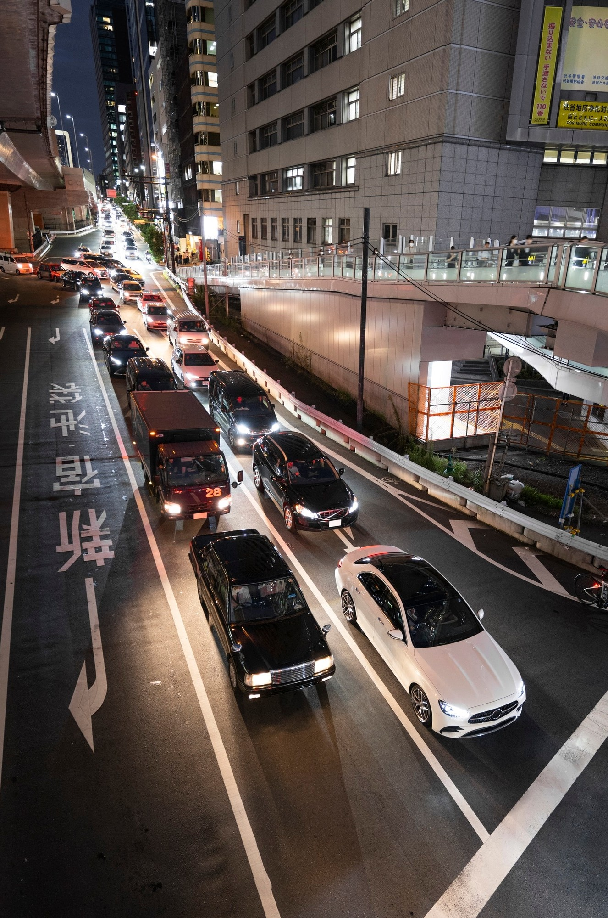
Introduction
Welcome to the presentation on Optimizing Fleet Management using an Objected-Oriented analysis and design approach. This session will explore key strategies for efficient fleet management.

Slide 3





Fleet Management Challenges
Fleet Management
Fleet management is the process of overseeing and coordinating the performance and maintenance of a fleet of vehicles. The goal is to ensure that the fleet runs efficiently, on time, and within budget.
A fleet manager oversees all commercial vehicles, drivers, and related assets, including their operations, conditions, external and internal policy compliance, and overall performance. Fleet managers ensure that vehicles and drivers are being utilized to their fullest potential in a safe and cost-effective manner.
Managing a fleet involves complex tasks such as route optimization, vehicle maintenance, and driver scheduling. These challenges require a systematic approach for effective management.

Slide 4
Problem Statement
A transportation company with a diverse fleet of vehicles, including trucks, vans, and cars, is facing operational inefficiencies and challenges in managing its fleet effectively. The company lacks a centralized system to track vehicle locations, monitor maintenance schedules, manage fuel consumption, oversee driver activities, and optimize route planning. This results in increased operational costs, frequent vehicle breakdowns, inefficient resource utilization, and compromised customer satisfaction.
To address these challenges, the company seeks a robust Fleet Management System (FMS) that leverages object-oriented analysis and design principles to develop a scalable and modular software solution. The FMS should facilitate real-time tracking of vehicle locations, automate maintenance scheduling, monitor fuel consumption, manage driver assignments, and optimize route planning to enhance operational efficiency and reduce costs. Additionally, the system should provide comprehensive reporting and analytics capabilities to enable data-driven decision-making and improve overall fleet performance.

Slide 5
Objective
"Objective: To design a modular and extensible object-oriented system architecture for a Fleet Management System that effectively models the various entities and interactions within a transportation company's fleet operations. This architecture should promote reusability, scalability, and maintainability while encapsulating the core functionalities of vehicle tracking, maintenance scheduling, fuel management, driver monitoring, and route optimization into cohesive and easily manageable software components. Additionally, the design should adhere to established object-oriented principles such as encapsulation, inheritance, and polymorphism to ensure flexibility and adaptability to evolving business requirements and technological advancements."

Slide 6
Gantt Chart

Slide 7
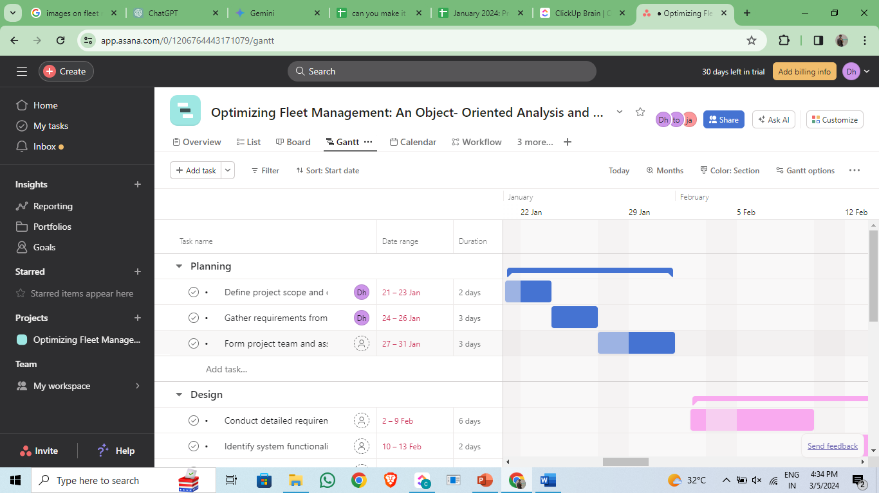

Slide 8
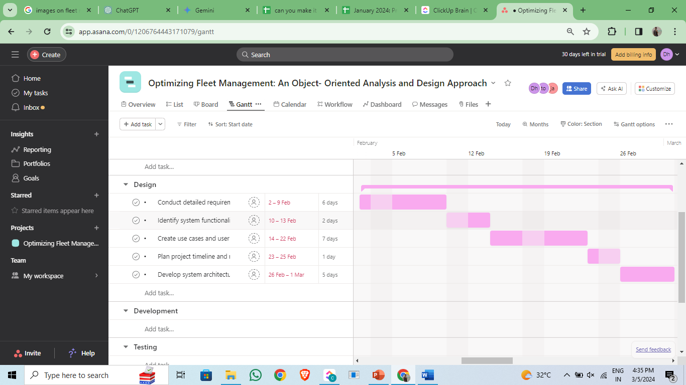

Slide 9
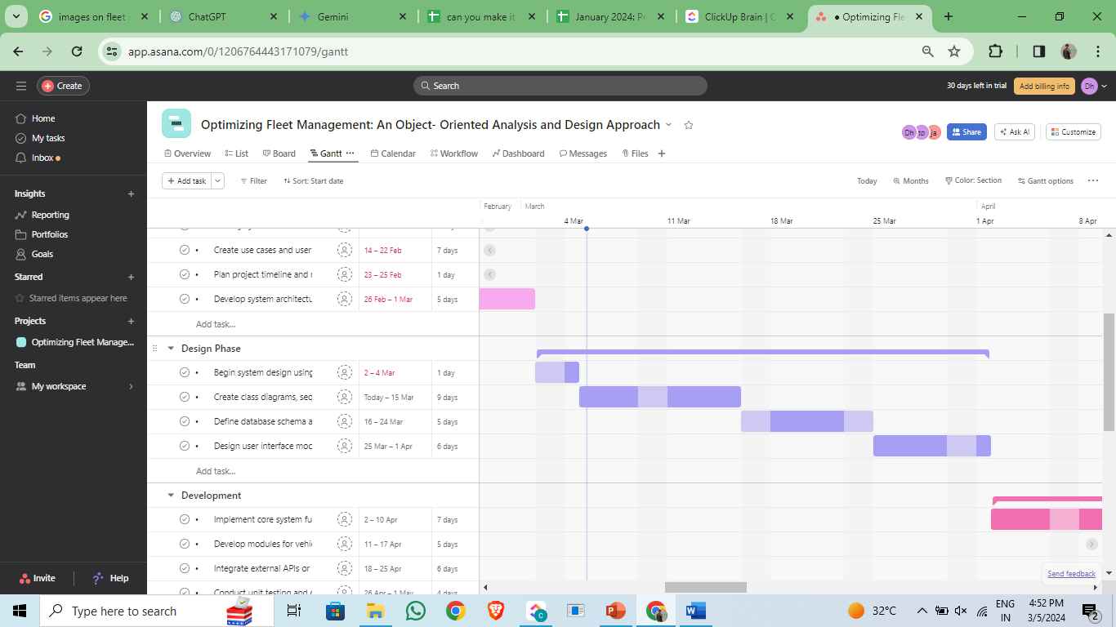

Slide 10
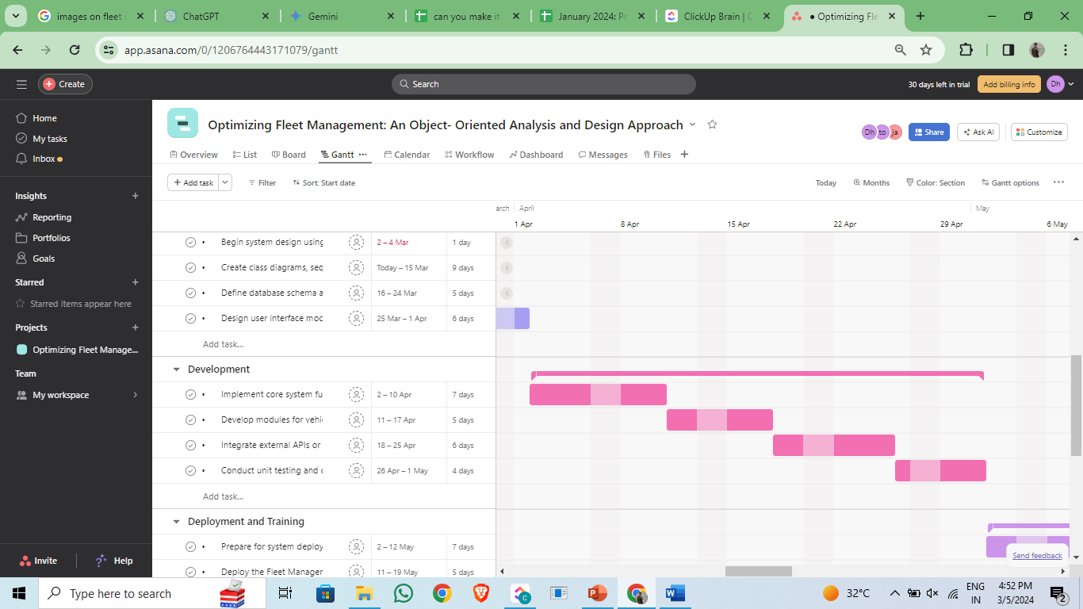

Slide 11
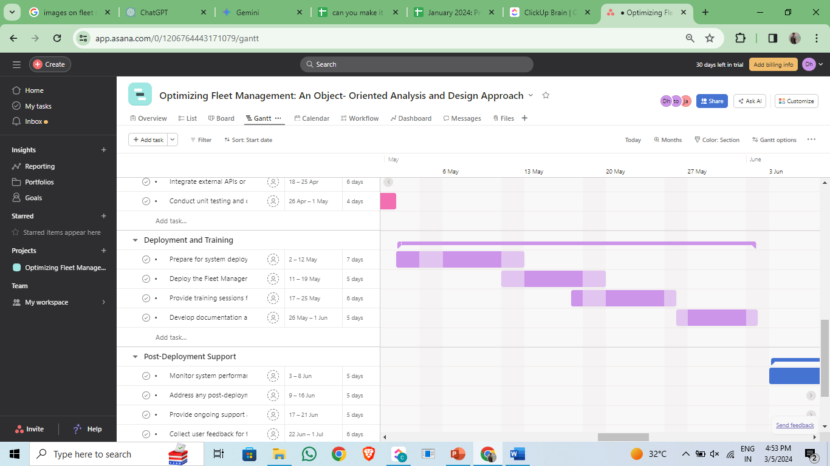

Slide 12
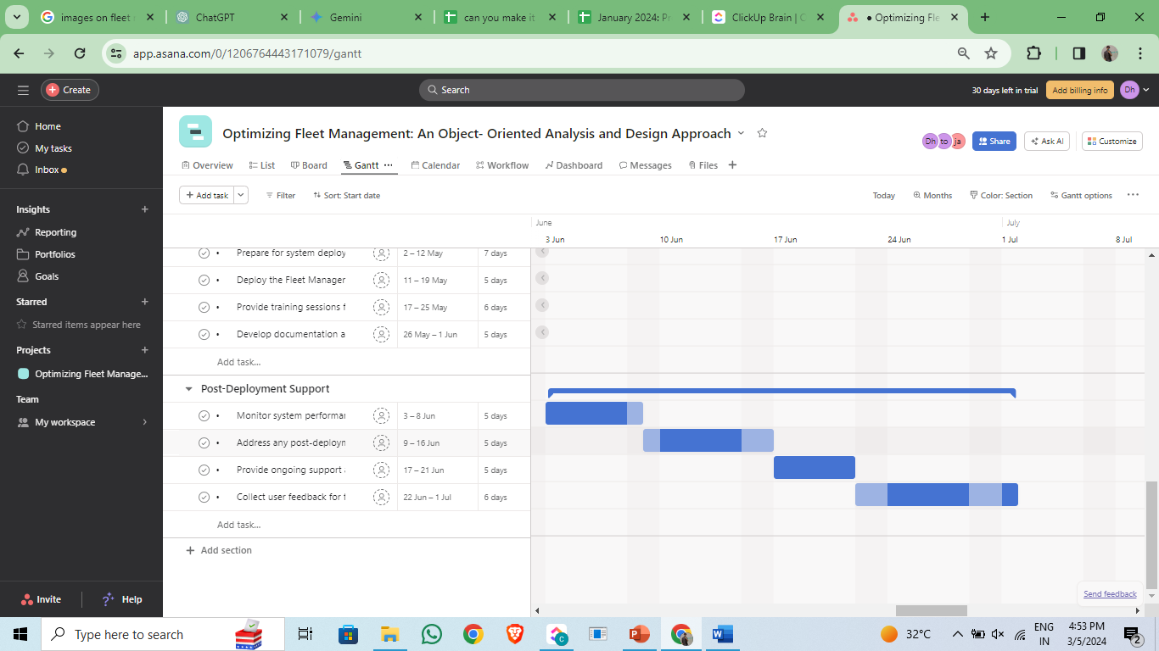

Slide 13
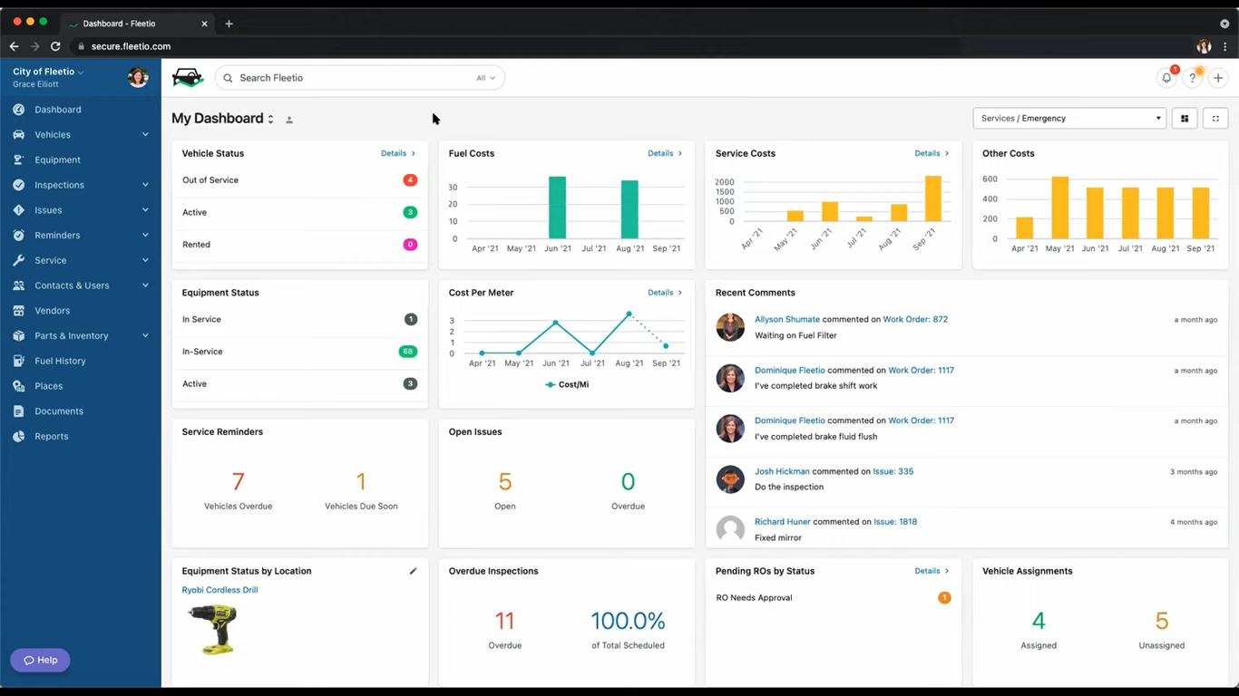

Slide 14


Object-Oriented Design
Utilizes inheritance, polymorphism, and encapsulation to create a flexible and maintainable fleet management system. This design approach ensures reusability and simplicity.
Involves identifying and organizing objects within the fleet management system. This approach focuses on creating a modular and scalable system design.

Slide 15


Data Modeling
Data modeling involves representing fleet management data using to visualize the system's structure and relationships. This step is crucial for understanding the data flow within the system.

Slide 16
Modules

Slide 17

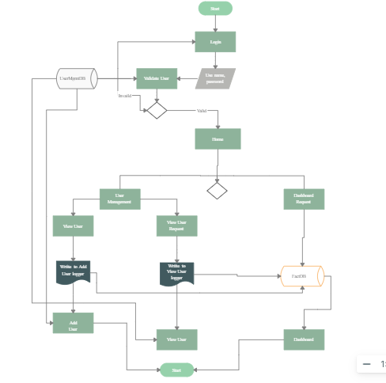

Module-1 Dashboard management

Slide 18
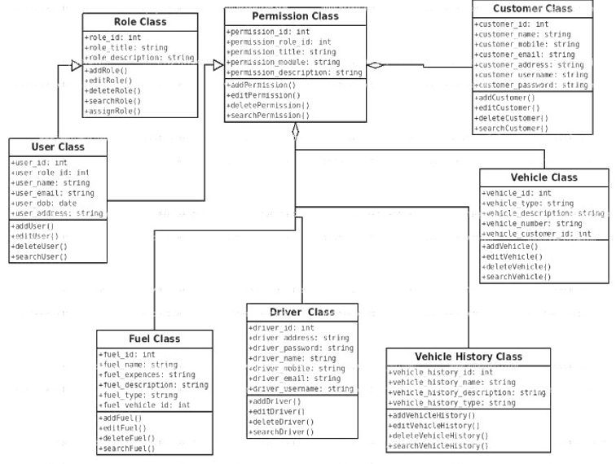
Module-2: Vehicle Maintenance

Slide 19
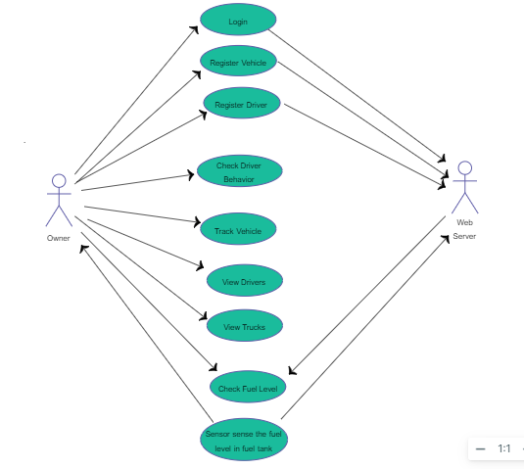
Module-3: Fuel Maintenance

Slide 20
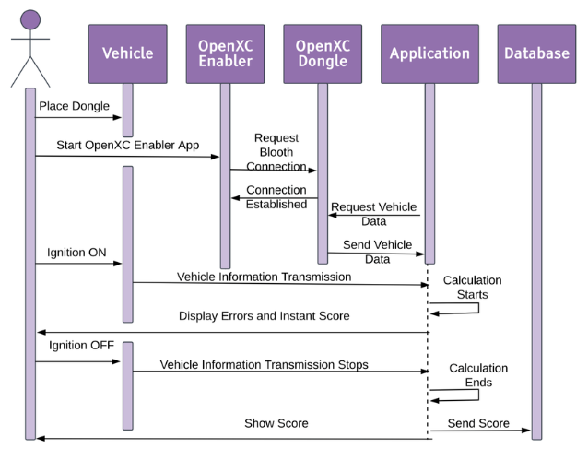
Module-4: Driver Behavior Monitoring

Slide 21
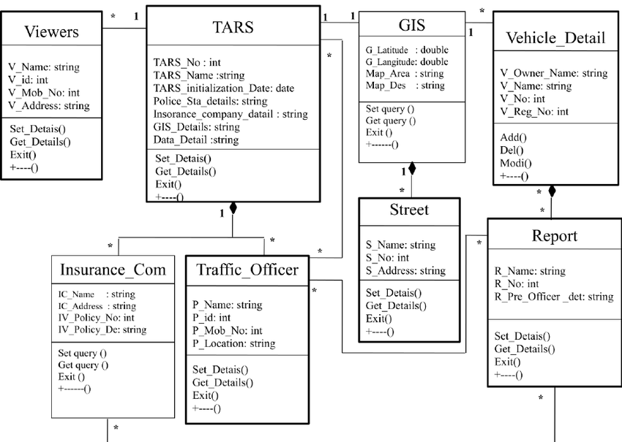
Module-5: Custom Reporting

Slide 22
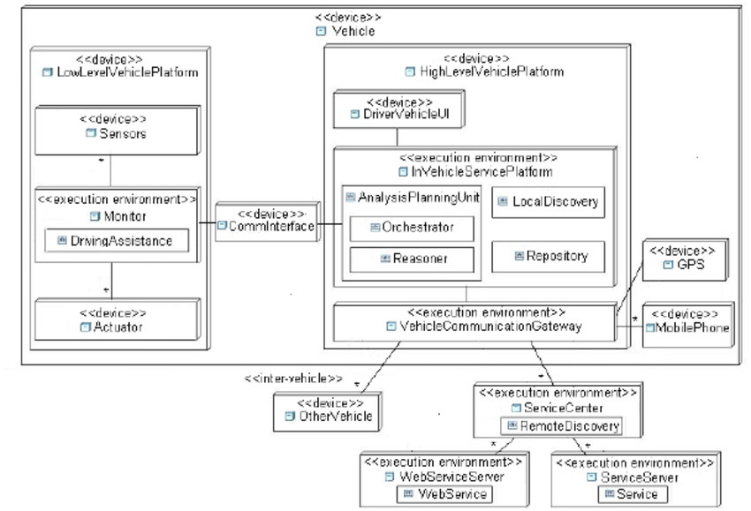
Module-6: Mobile Accessibility

Slide 23
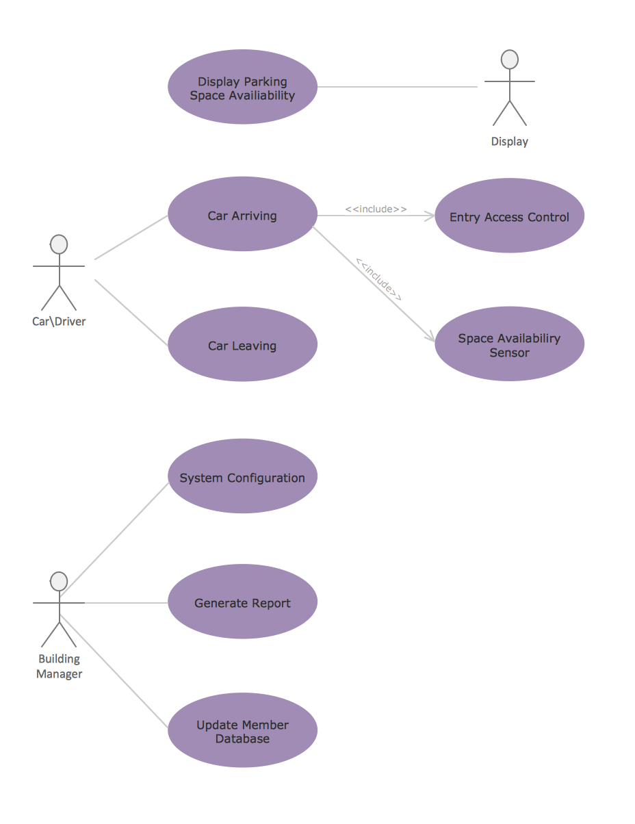

How can we design a fleet management system that monitors vehicle locations, schedules maintenance tasks, and analyzes data to optimize routes and reduce fuel consumption for transportation companies?

Slide 24
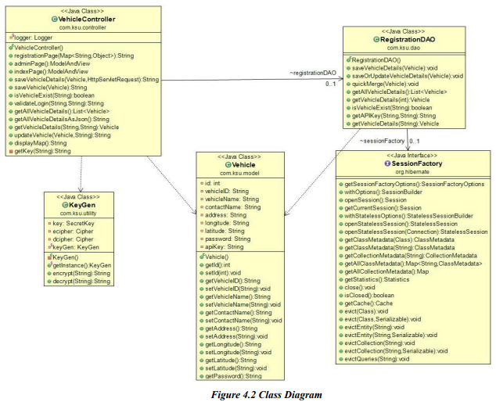
Evaluate the design of the class diagram for the Fleet Management System, analyzing its adherence to object-oriented principles such as encapsulation, inheritance, and association. Assess the relationships between classes representing vehicles, drivers, routes, and maintenance schedules, ensuring clarity, cohesion, and extensibility in the design. Propose modifications or additions to the class diagram to accommodate evolving business requirements and improve system scalability.

Slide 25
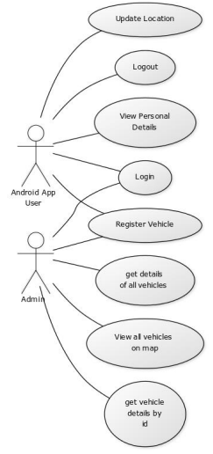
Critically assess the use case diagram depicting the various actors and their interactions with the Fleet Management System. Evaluate the coverage of user scenarios and system functionalities, ensuring completeness and relevance in addressing business processes such as vehicle assignment, trip planning, and maintenance scheduling. Propose enhancements or refinements to the use case diagram to capture additional user roles or streamline complex workflows.

Slide 26
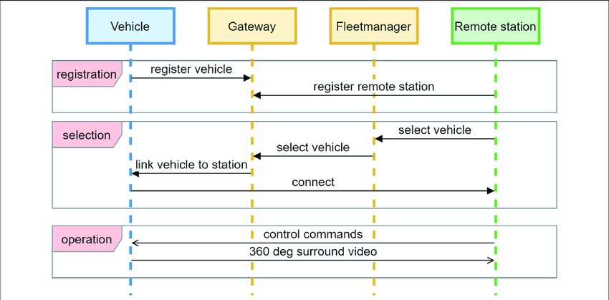
Analyze the sequence diagrams illustrating the sequence of interactions between actors, system components, and external systems in the Fleet Management System. Evaluate the effectiveness of sequence diagrams in depicting the flow of control and data during use case scenarios such as vehicle dispatching, fuel tracking, and driver scheduling. Propose optimizations or alternative representations to enhance the clarity and comprehensibility of sequence diagrams.

Slide 27
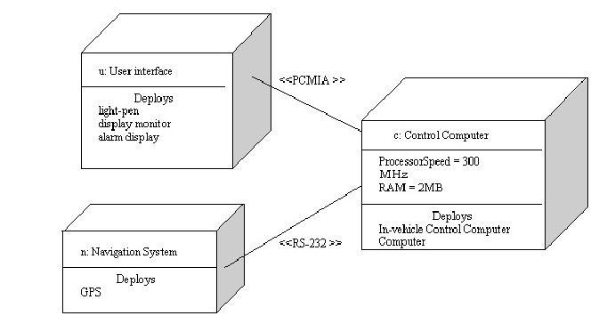
Evaluate the deployment diagram for the Fleet Management System, assessing the allocation of system components to physical nodes and their connectivity. Analyze the scalability, reliability, and performance implications of the deployment architecture in supporting distributed operations across multiple locations or fleets. Propose optimizations or alternative deployment strategies to improve system availability and resource utilization.

Slide 28
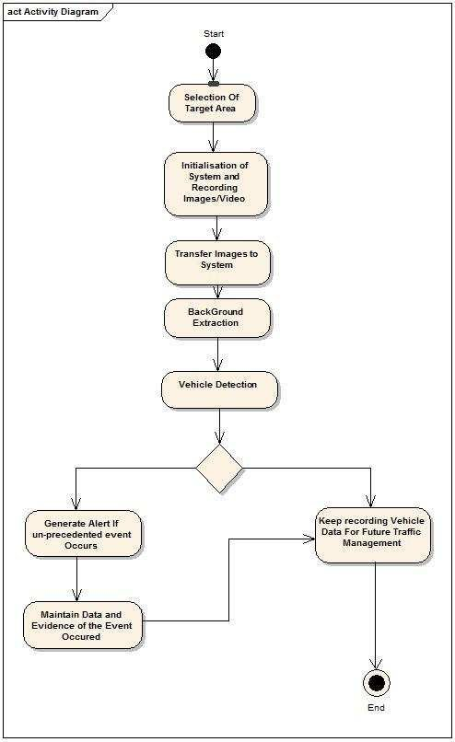
Critically assess the activity diagrams depicting the workflow of key business processes such as vehicle maintenance, driver training, and route optimization in the Fleet Management System. Analyze the clarity, completeness, and efficiency of activity diagrams in representing complex process flows, decision logic, and exception handling. Propose refinements or restructuring of activity diagrams to streamline workflow execution and improve system efficiency.

Slide 29

System Architecture
The system architecture focuses on creating a scalable and flexible platform for fleet management. It involves defining layers and components for seamless integration.

Slide 30




Performance Optimization
Efficient fleet management requires real- time data processing, predictive maintenance, and dynamic routing. These optimizations enhance overall fleet performance and reduce operational costs.

Slide 31

Driver Empowerment
Empowering drivers with intuitive interfaces, real-time navigation, and performance feedback enhances their productivity and satisfaction. This approach contributes to overall fleet efficiency.

Slide 32

Cost Optimization
Strategies such as fuel efficiency, route optimization, and asset utilization contribute to cost savings in fleet management. These optimizations lead to a more sustainable and profitable operation.

Slide 33



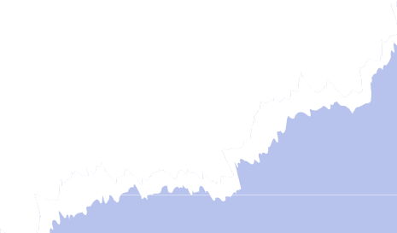
Conclusion
In conclusion, an approach to fleet management offers a systematic and scalable solution to the challenges faced in fleet operations. By integrating
, , and , organizations can achieve enhanced efficiency and cost savings.
Successful implementation require stakeholder collaboration, training programs and gradual deployment. These considerations ensure a smooth transition to the new fleet management system.

Slide 34


Thanks!
Do you have any questions?
dhanushdhanushj816@gmail.com
thoufiqsyed15@gmail.com
jashuvaofficial44@gmail.com

